Slide 1

The Impact of Opioid Control Policies –
Florida, Texas, Washington
Weiliang Hu, Emma Mavis, Fides Schwartz, Yongxin Tan

Slide 2
Background
The United States has had an opioid addiction crisis since the early 2000s
Many attempts have been made to curb this by policymakers on a state and federal level

Slide 3
Purpose
Assess the effects of policy changes in Florida (2007), Texas (2010) and Washington (2012) on opioid overdose related death rates and opioid shipments in Florida and Washington.

Slide 4
Methods

Slide 5
Materials and Methods
We used data from the Washington Post, the CDC and the Census
We chose three comparison states for each state that implemented a policy change to account for other factors that may have influenced opioid deaths and shipments
The data from the three comparison states was pooled to make comparison more comprehensive

Slide 6
Materials and Methods
Comparison states for Florida were:
Arizona, Colorado and Louisiana
Comparison states for Texas were:
Kansas, Mississippi and Wisconsin
Comparison states for Washington were:
Arizona, Colorado and Oklahoma
Based on 2005 opioid death rates and the fact that they did not implement policy changes during our period of observation

Slide 7
Results

Slide 8
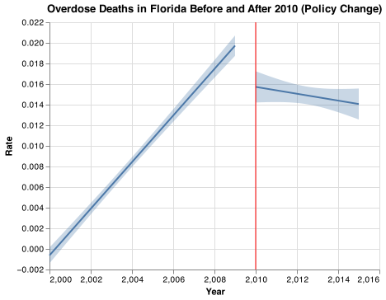
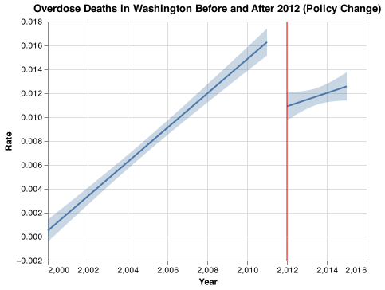
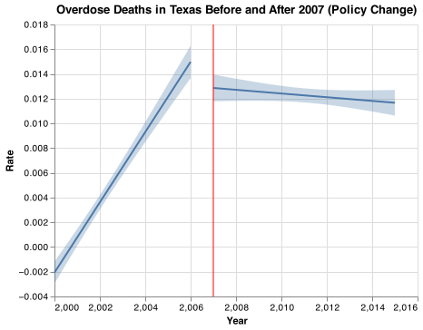
Death rates in each state before and after policy changes

Slide 9
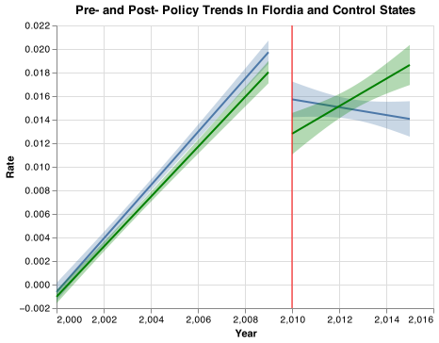
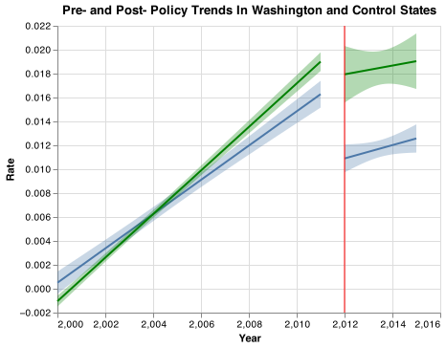
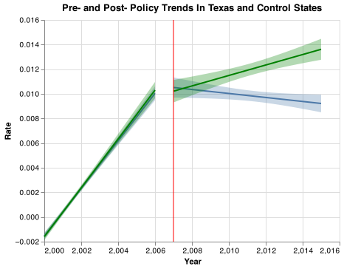
Death rates before and after policy changes – comparison states

Slide 10
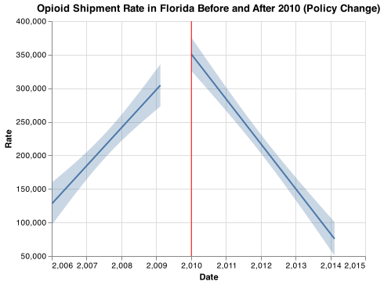
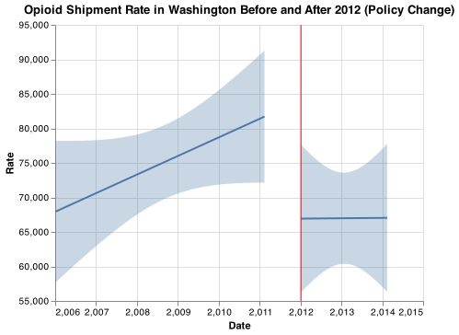
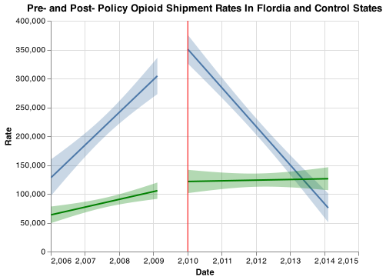
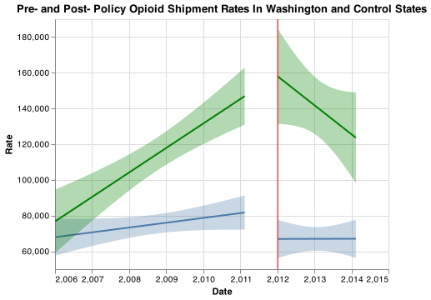
Shipment rates before and after policy changes – comparison states

Slide 11
Discussion

Slide 12
Limitations
Not completely homogenous response
There may have been other changes that influenced opioid deaths and shipments (e.g. prescription practices)

Slide 13
Conclusions
Policy changes on a state level have a beneficial effect on opioid overdose related deaths and shipments
These results are encouraging and may entice other policy makers to implement similar changes

Slide 14
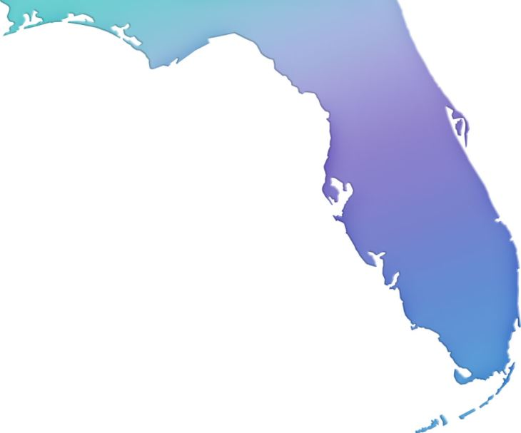


Thank you!
https://fcit.usf.edu/florida/maps/pages/11300/f11359/f11359-09.htm, https://www.istockphoto.com/illustrations/texas-shape, https://freevectormaps.com/united-states/washington/US-WA-EPS-01-0001

